Slide 1
Generative AI Capabilities

Slide 2

About me
Over a decade of experience driving AI advancements across Government, Telecom, Finance Insurance, Healthcare, Education and more.
Designed predictive models, automation, and customer engagement strategies for global corporations.
Trained professionals from top firms like Bain and Co., JP Morgan, NOKIA, IndiGo etc. and senior government officials up to Executive Director level from Government of India Ministry of Communications, Ministry of Skilling and Entrepreneurship and Ministry of Education.
Introduced Artificial Intelligence and Generative AI to State government employees from Uttar Pradesh, Chandigarh and Himachal Pradesh and PSUs like Gujarat Alkalies and Chemicals Limited (GACL)
Aashutosh Kumar Mishra

Slide 3
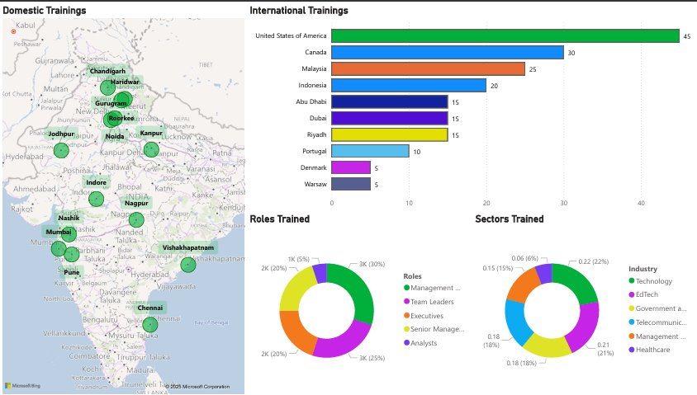
About me ​

Slide 4
Agenda – Day 2
Module 2:
Prompt Engineering Mastery
Essential components of a successful prompt
Prompt Templates
Effective prompting strategies - few-shot prompting, c-o-t prompting, t-o-t prompting etc.
Prompt chaining and Role-based prompting for specialized outputs
Hands-on Activities
Module 3:
Retrieval-Augmented Generation (RAG)
Typical RAG Workflow
Hands-on Activities
Module 4: Copilots and AI Agents
• Agent vs. Copilot vs. Chatbot
• Agentic Workflows: Task decomposition, planning, memory

Slide 5
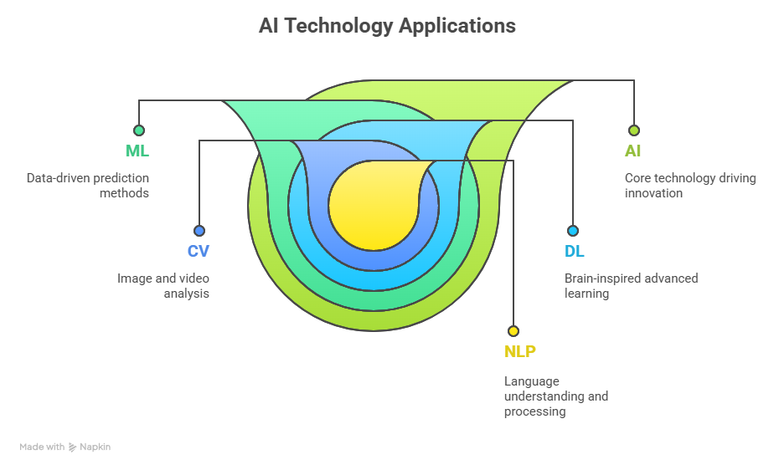
AI and its Types
AI is not just a futuristic concept—it’s a practical tool to solve today's challenges across industries.

Slide 6
Understanding Generative AI
Generative AI is a subset of classical artificial intelligence where models generate text, images, and data-based insights.
Text Generation: Writing articles, product descriptions, customer responses
Image Generation: Creating marketing visuals, designs, artwork
Video/Audio Generation: Deepfakes, video scripts, music composition
Code Generation: Automated code completion and debugging
Speech Generation: AI voice assistants
Artificial Intelligence
Machine Learning
D
Deep Learning
Generative AI

Slide 7

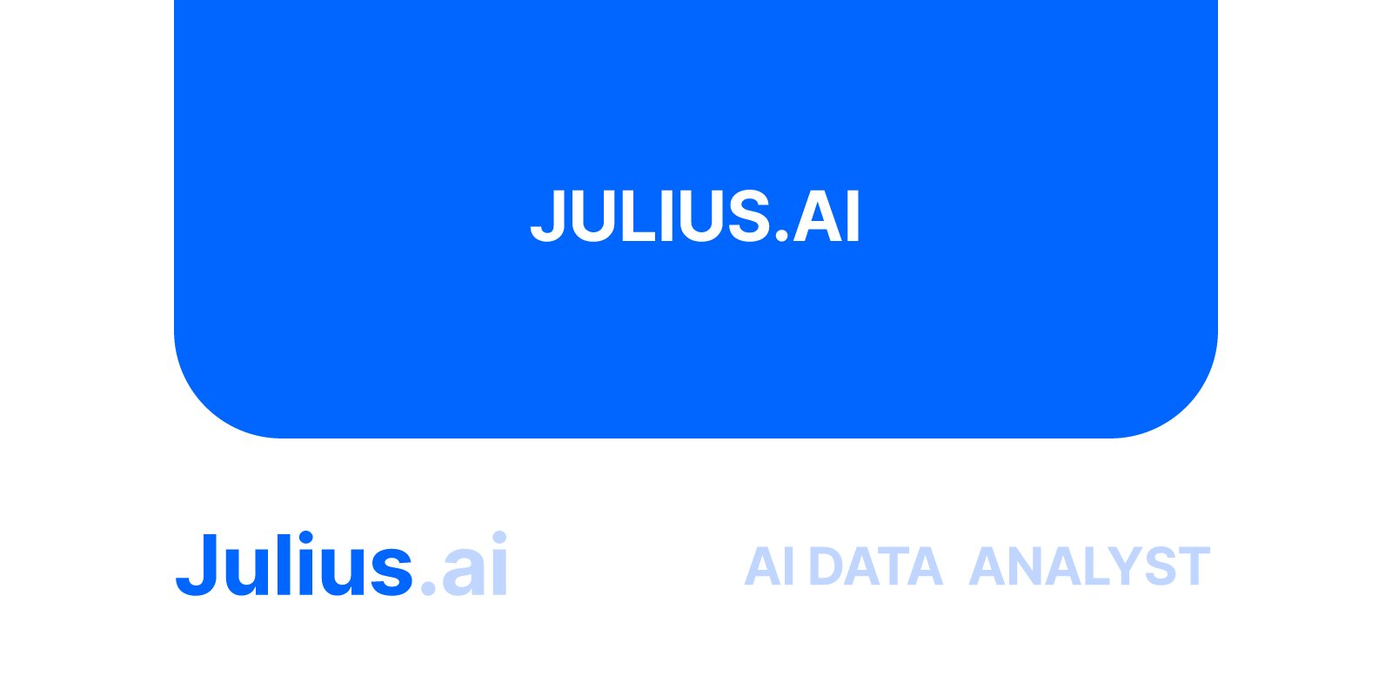










Slide 8
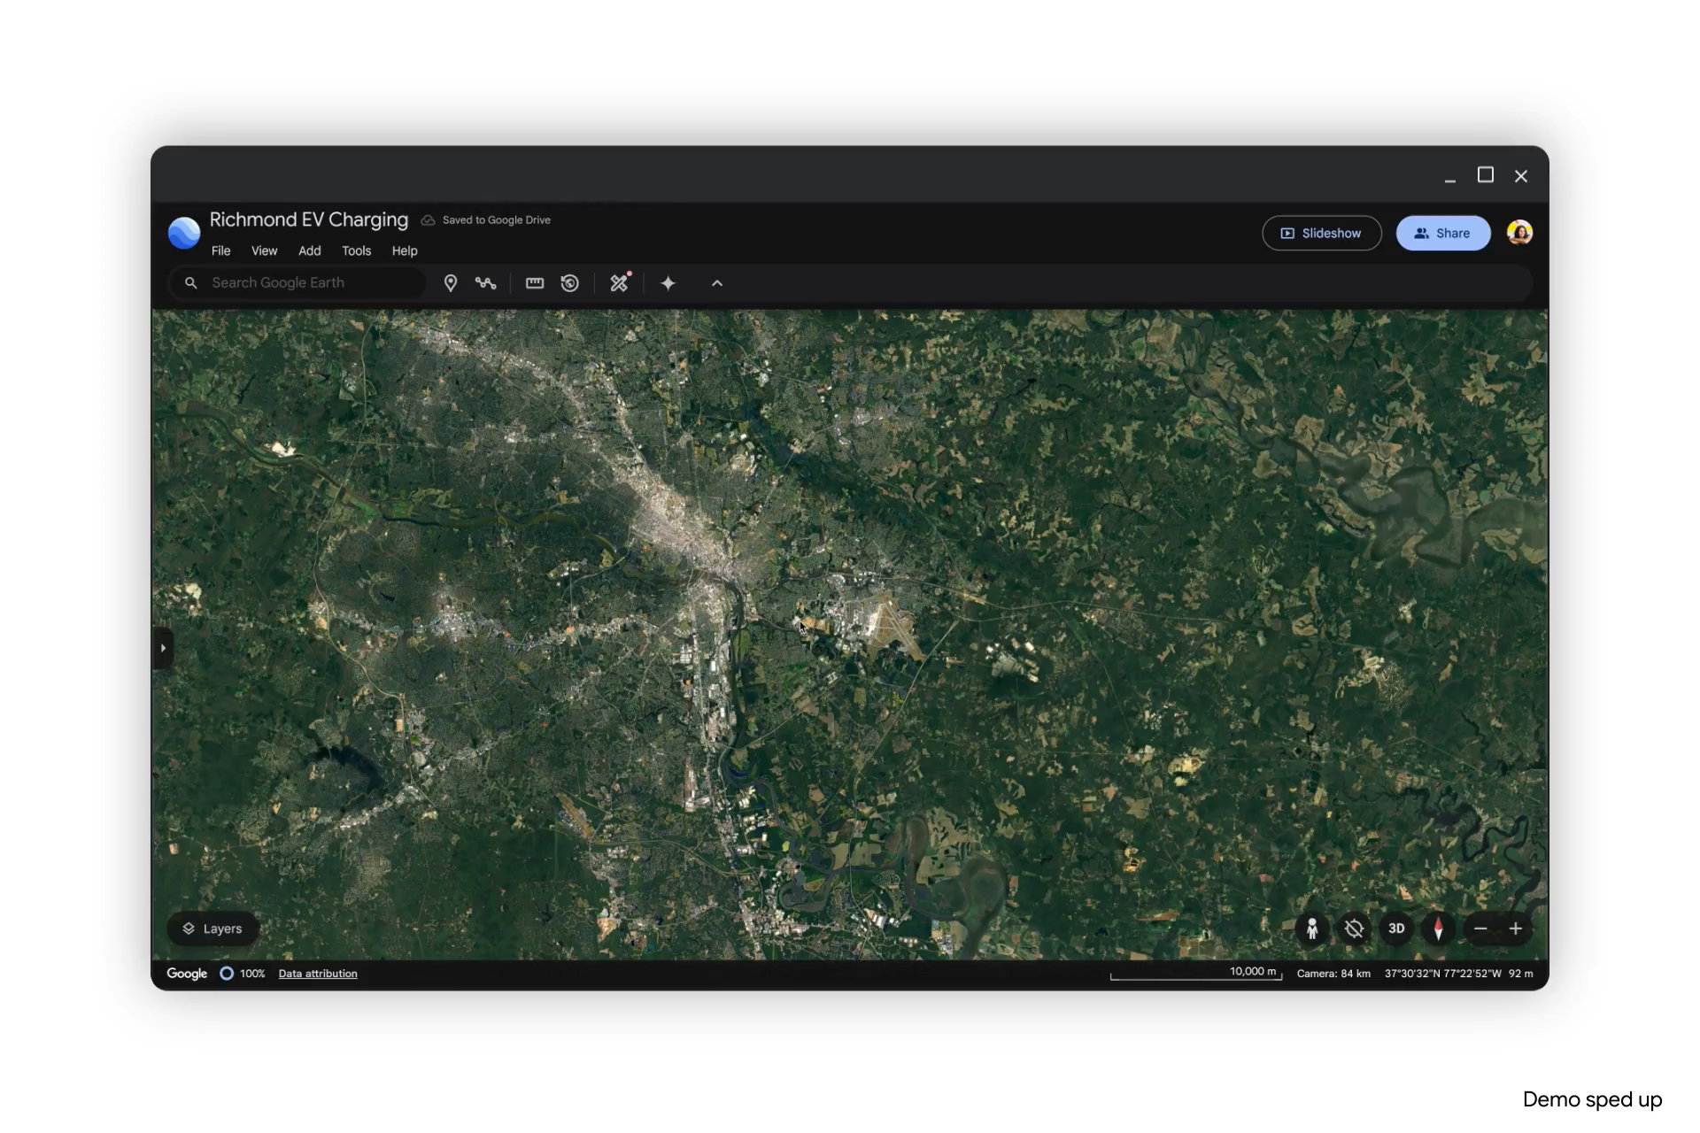

Slide 9
Understanding Open AI ChatGPT and its capabilities
ChatGPT act as a potential language generating model that manages various NLP tasks such as
Text Generation
Open AI ChatGPT 4 and 4o
ChatGPT is competent in generating text that appears to be generated by human. Useful for writing, content creation, etc.
01
Dialogue Generation
02
Prepare responses in a conversation-like manner. Useful for building chatbots and offering virtual assistance
Salient features of ChatGPT
03
Language Translation
Chat-GPT is fine-tuned for language translation tasks. Useful for chatbot or customer service applications
Optimum quality responses to queries
Large- scale training
Generate dynamic and in-depth virtual responses for each task assigned in written form
Offer better conversational communication
Platform is trained on huge amount of textual data enabling it to offer wide range of responses
Competent in completing tasks related to text generation, translation, summarization, etc.
Functionalities of ChatGPT
04
Text Summarization
Fine-tuned for text summarization tasks. Useful for new articles, detailed documents, etc.
01
02
05
Text Classification
Model can be modified for text classification task. Useful for sentiment analysis, intent recognition, and additional NLP applications
04
03
Adaptability
Use of ChatGPT
06
ChatGPT can be modified or fine-tuned to perform certain tasks with specific training
Potential in code writing and debugging, capable in writing poems, songs, essays & articles
Question Answering
Model can be tweaked for question-answering assignments. Useful for chatbots and customer service applications
07
Text Completion
Model can be modified for text-completion assignment. Useful for predictive text input and additional applications.
​​

Slide 10
Large Language Models
Large Language Models (LLMs) are state-of-the-art AI models designed to comprehend and generate human language.
Large
Refers to the significant size and complexity of these models, which contains hundreds of millions or even billions of parameters
Language
Denotes their primary function, which is to understand and generate human language
Describes them as mathematical representations that capture the patterns and structure of language data
Model
Notes:
This slide is self-explanatory.

Slide 11

Components of LLMs
Tokenization
Embedding
Attention
Pretraining
This process involves breaking down text into smaller units called tokens, which can be words, phrases, or even individual characters.
Transfer learning
Encoder and decoder
Scaling
Notes:
Instructor Notes: This slide is self-explanatory.

Slide 12
Components of LLMs
Tokenization
Embedding
Attention
Pretraining
This embedding component maps tokens to a high-dimensional vector space, representing each token with a unique vector.
Transfer learning
Encoder and decoder
Scaling
Notes:
Instructor Notes: This slide is self-explanatory.

Slide 13
Components of LLMs
Tokenization
Embedding
Attention
Pretraining
This attention mechanism lets the model concentrate on specific parts of the input text when generating output.
Transfer learning
Encoder and decoder
Scaling
Notes:
Instructor Notes: This slide is self-explanatory.

Slide 14
Components of LLMs
Tokenization
Embedding
Attention
Pretraining
This involves pretraining LLMs on extensive text data to understand the underlying patterns and structures of human language.
Transfer learning
Encoder and decoder
Scaling
Notes:
Instructor Notes: This slide is self-explanatory.

Slide 15
Components of LLMs
Tokenization
Embedding
Attention
Pretraining
This component allows the model to adapt to new tasks by fine-tuning the pre-trained model on a smaller dataset.
Transfer learning
Encoder and decoder
Scaling
Notes:
Instructor Notes: This slide is self-explanatory.

Slide 16
Components of LLMs
Tokenization
Embedding
Attention
Pretraining
This employs the Transformer framework in a large language model architecture, comprising two main parts: an encoder and a decoder.
Transfer learning
Encoder and decoder
Scaling
Notes:
Instructor Notes: This slide is self-explanatory.

Slide 17
Components of LLMs
Tokenization
Embedding
Attention
Pretraining
This necessitates significant computational resources for training and upkeep, making scaling a challenging but essential part of its architecture.
Transfer learning
Encoder and decoder
Scaling
Notes:
Instructor Notes: This slide is self-explanatory.

Slide 18
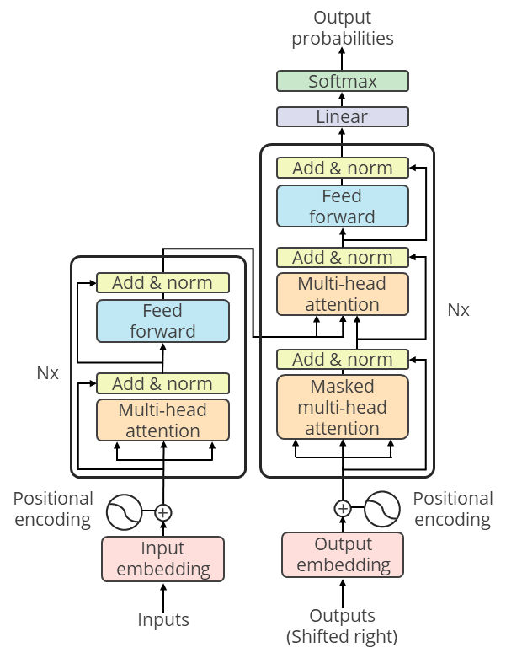
LLM Architecture
Components of LLM architecture
Input embeddings
Positional encoding
Encoder
Attention mechanism
Feed-forward neural network
Decoder
Multi-headed attention
Layer normalization
Output
Notes:
Instructor Notes: This slide is self-explanatory.

Slide 19
LLM Operations
These represent the functions of components within an architecture.
Input embeddings
Positional encoding
The machine takes in a sentence and breaks it down into smaller pieces.
Each of these pieces is turned into a special kind of code that the machine can understand.
This code holds the meaning of the words.
Encoder
Decoder
Multi-headed attention
Layer normalization
Output
Notes:
This slide is self-explanatory. Use the real-world example given below to explain.
Scenario:
Imagine you're typing a message on your smartphone. As you start typing, the phone predicts and suggests the next word or words in your sentence. This prediction is not just based on the initial letters you've typed; it also considers the context of what you've written so far.
Input Embeddings:
As you type, the language model converts each partial word or word fragment into a code that represents its meaning.

Slide 20
LLM Operations
These represent the functions of components within an architecture.
Input embeddings
Positional encoding
The machine wants to understand not just what words are there but also their order in the sentence.
So, it adds some extra information to the code to show where each word is in the sentence.
Encoder
Decoder
Multi-headed attention
Layer normalization
Output
Notes:
Positional Encoding:
It considers the order in which you're typing the words to understand the context. For example, I like might be different from Like, I.

Slide 21
LLM Operations
These represent the functions of components within an architecture.
Input embeddings
Positional encoding
Encoder: Now, the machine gets to work on analyzing the sentence. It creates a bunch of memories to remember what it has read.
Attention mechanism: The machine pays more attention to some words depending on their importance in the sentence.
Feed forward: After paying attention to words, the machine thinks hard about each word on its own.
Encoder
Decoder
Multi-headed attention
Layer normalization
Output
Notes:
Encoder:
The language model analyzes the words you've typed, creating hidden states that capture the context of your message.
Self-Attention Mechanism:
It pays more attention to critical words based on the context. For instance, if you've typed "Let's meet at the," it gives more weight to locations or time-related words for better predictions.
Feed-Forward Neural Network:
The model thinks about each word in the context of the sentence, capturing the nuances of language.

Slide 22
LLM Operations
These represent the functions of components within an architecture.
Input embeddings
Positional encoding
The machine not only understands but also generates new sentences.
For this, it has a special part called the decoder.
The decoder helps the machine predict what word comes next based on what it has understood so far.
Encoder
Decoder
Multi-headed attention
Layer normalization
Output
Notes:
Decoder Layers:
The model predicts the next word based on what it understands so far. If you've typed "I am going to the," it might suggest words like "store" or "park" based on typical language patterns.

Slide 23
LLM Operations
These represent the functions of components within an architecture.
Input embeddings
Positional encoding
The machine looks at the words in different ways simultaneously.
This helps the machine grasp different aspects of the sentence all at once.
Encoder
Decoder
Multi-headed attention
Layer normalization
Output
Notes:
Multi-Head Attention:
Different aspects of your partial sentence are considered simultaneously. For example, it looks at both the beginning and the middle of your sentence at the same time.

Slide 24
LLM Operations
These represent the functions of components within an architecture.
Input embeddings
Positional encoding
This layer is in place to keep everything in check and make sure the machine learns well.
The machine normalizes its understanding at each step.
Encoder
Decoder
Multi-headed attention
Layer normalization
Output
Notes:
Layer Normalization:
Normalization helps maintain the accuracy of predictions, ensuring that the model generalizes well across different sentences.

Slide 25
LLM Operations
These represent the functions of components within an architecture.
Input embeddings
Positional encoding
Finally, the machine produces its own understanding or generates new sentences.
The output depends on what the machine is designed to do.
For example, if it's predicting the next word in a sentence, it gives a probability for each word.
Encoder
Decoder
Multi-headed attention
Layer normalization
Output
Notes:
Output Layers:
The model generates suggestions for the next word. For instance, if you've typed I have a, it might suggest meeting or question based on common language usage.

Slide 26
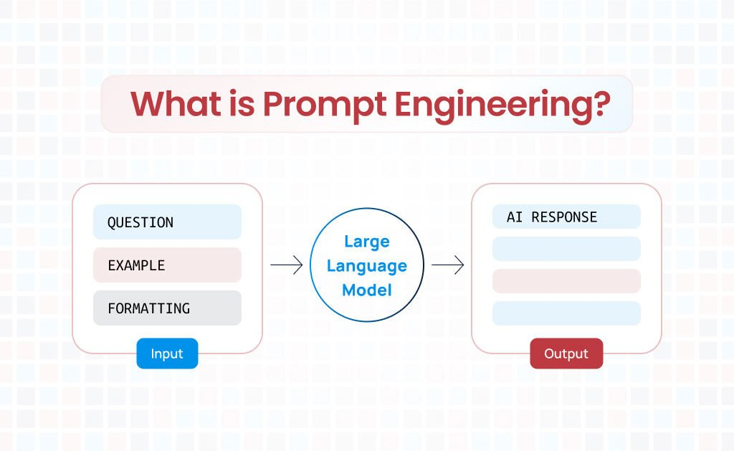
Exploring Prompts and Prompt Engineering
The art of designing clear and specific instructions for AI to generate precise, structured, and high-quality responses.
Helps customize AI-generated content to meet government standards and compliance requirements.
By mastering prompt engineering, government employees can harness Generative AI effectively to create clear, compliant, and professional communication.

Slide 27
Components of a Prompt
Instruction
This is the core directive of the prompt. It tells the model what you want it to do. For example, "Summarize the following text" provides a clear action for the model.
Context
Context provides additional information that helps the model understand the broader scenario or background. For instance, "Considering the economic downturn, provide investment advice" gives the model a backdrop against which to frame its response.
Input data
This is the specific information or data you want the model to process. It could be a paragraph, a set of numbers, or even a single word.
Output indicator
Especially useful in role-playing scenarios, this element guides the model on the format or type of response desired. For instance, "In the style of Shakespeare, rewrite the following sentence" gives the model a stylistic direction.

Slide 28
Best Practices for Writing Effective Prompts
Be Specific & Clear – Provide details about the purpose, tone, and format of the letter.
"Draft a formal letter from the Ministry of Health to all state governments regarding a new vaccination drive. Keep it concise and include key dates and guidelines."
Define the Structure – Guide AI on the format required.
"Create a government memo with a subject line, introduction, key points, and a closing statement."
Iterate & Refine – Use follow-up prompts to fine-tune responses.
"Make the tone more formal and add a call to action for department heads."

Slide 29
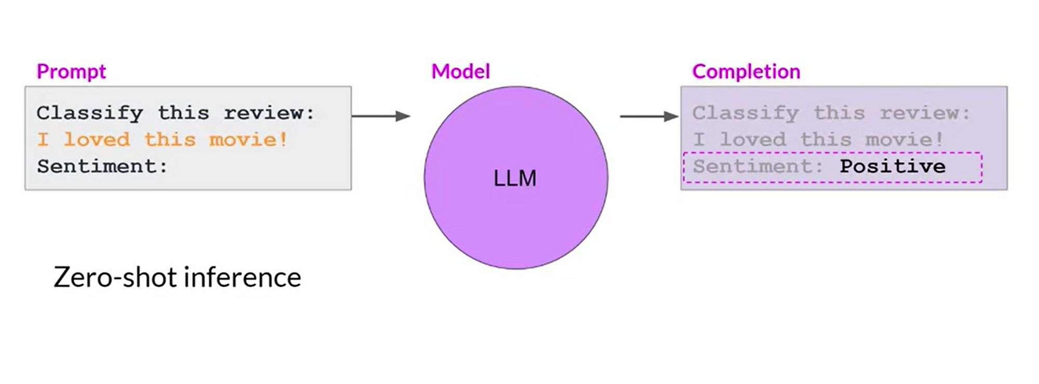
Prompting Strategies: From Zero-Shot to Few-Shot and Beyond
1. Zero-Shot Prompting
Definition: The AI is given a clear instruction but no examples. It relies entirely on its pre-trained knowledge to generate the output.
Strengths:
Fast, simple, and works well for common or straightforward tasks.
No need for extra context.
Limitations:
May misinterpret ambiguous or complex tasks.
Output quality can be inconsistent for nuanced or domain-specific queries.
Example:
Prompt:
Q: If a shirt costs $20 and you buy 3 shirts, how much do you pay?
Model Answer (Zero-shot): You pay $60.
The model directly answers without any prior context or examples.

Slide 30
Prompting Strategies: From Zero-Shot to Few-Shot and Beyond
2. One-Shot Prompting
Definition: The AI receives a single example along with the instruction. This clarifies the expected format or style.
Strengths:
Provides a reference for the AI, improving output consistency.
Useful for slightly more complex tasks.
Limitations:
Still limited in pattern recognition; may not generalize well for varied inputs.
Prompt:
Example: Q: If a pen costs $2 and you buy 5 pens, how much do you pay? A: $10
Now answer this:
Q: If a shirt costs $20 and you buy 3 shirts, how much do you pay?
Model Answer (One-shot): $60
It learns from one example how to format the answer.

Slide 31
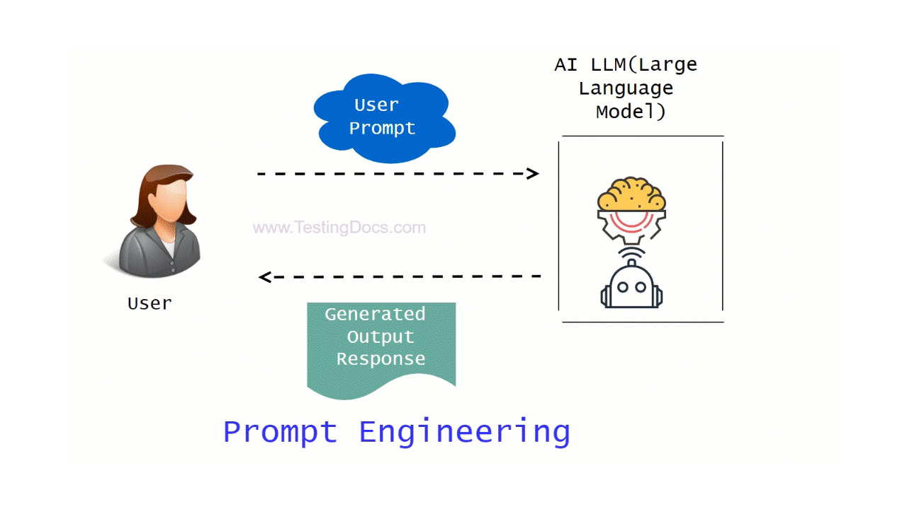
Prompting Strategies: From Zero-Shot to Few-Shot and Beyond
3. Few-Shot Prompting
Definition: The AI is given multiple examples (typically 2–5) before the main task. This helps the model recognize patterns and produce more accurate, relevant, and structured responses.
Strengths:
Greatly improves performance on complex, nuanced, or domain-specific tasks.
Ensures output consistency and adherence to desired formats.
Limitations:
Requires more effort to prepare examples.
Prompts can become lengthy.

Slide 32
Prompting Strategies: From Zero-Shot to Few-Shot and Beyond
Prompt:
Example 1: Q: If a book costs $10 and you buy 2 books, how much do you pay? A: $20
Example 2: Q: If a pen costs $3 and you buy 4 pens, how much do you pay? A: $12
Example 3: Q: If a hat costs $15 and you buy 2 hats, how much do you pay? A: $30
Now answer this: Q: If a shirt costs $20 and you buy 3 shirts, how much do you pay?
Model Answer (Few-shot): $60
The multiple examples help the model infer the pattern and style.
4. Role-Based Prompting: Assign a role, e.g., “You are a rural development officer. Explain...”
5. Instruction + Constraints: Specify output format, length, or style.

Slide 33
Prompting Strategies: From Zero-Shot to Few-Shot and Beyond
6. Chain of Thought: You explicitly ask the model to show reasoning step by step before giving the final answer.
Prompt:
Q: If a shirt costs $20 and you buy 3 shirts, how much do you pay? Let’s reason step by step.
Model Answer (CoT):
One shirt costs $20.
You are buying 3 shirts.
Multiply 20 × 3 = 60.
So, you will pay $60.
Encourages intermediate reasoning rather than jumping straight to the answer.

Slide 34
Prompting Strategies: From Zero-Shot to Few-Shot and Beyond
7. Tree of Thought: The model explores multiple reasoning paths, evaluates them, and then picks the best one.
Prompt:
Q: If a shirt costs $20 and you buy 3 shirts, how much do you pay? Think in multiple ways, explore different reasoning paths, and pick the best answer.
Model Answer (ToT):
Path 1: Multiply directly → 20 × 3 = 60. Path 2: Add cost repeatedly → 20 + 20 + 20 = 60. Path 3: Think in terms of groups → 2 shirts = 40, add 1 shirt = 20 → total 60.
All reasoning paths give the same result --> Best answer: $60.
ToT allows exploration of different approaches and cross-verification before finalizing.

Slide 35
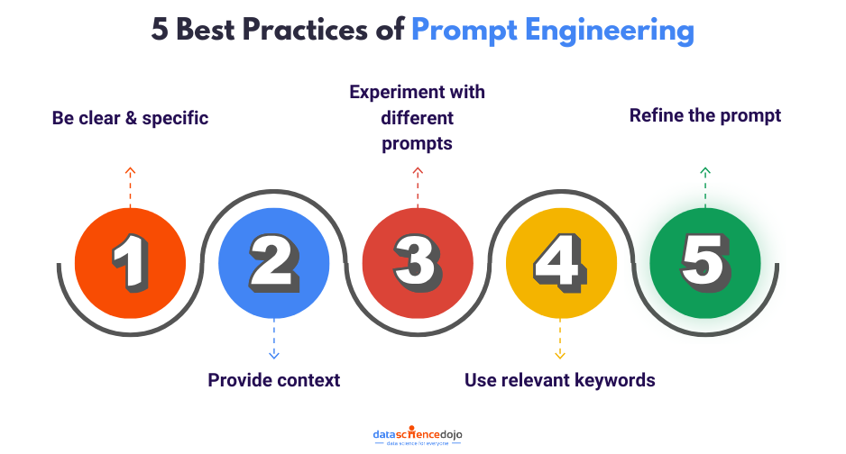
Approach | Prompt Example | Expected Output | Output Quality
Normal (Zero-Shot) | “List challenges in MNREGA implementation.” | May list a few challenges, possibly generic or incomplete. | Variable, may lack depth or structure.
Systematic (Few-Shot, Structured) | “List three challenges in MNREGA implementation. Example: 1. Delay in wage payments. 2. Fake job cards. 3. Insufficient monitoring. Now, list three challenges in PMAY-G implementation.” | 1. Land availability issues. 2. Delays in fund disbursement. 3. Quality of construction. | Consistent, relevant, and well-structured

Slide 36
Types of LLMs: GPT 4
This model is OpenAI’s most advanced version, integrating multimodal capabilities for text, image, and audio processing.
Performance
It performs like a human on tests. It mimics human-like speech and reasoning.
Pros
The model excels in multilingual processing, complex reasoning, and real-time interactions.
Cons
While powerful, GPT-4o still has potential biases and requires significant computational resources.
Notes:
Instructor Note: This slide is self-explanatory.

Slide 37
Types of LLMs: Claude 3.5 Sonnet
This model is the latest addition to Anthropic's Claude series, designed to enhance reasoning, accuracy, and response reliability while prioritizing AI safety and ethical considerations.
Performance
It delivers increased response times, improved contextual understanding, and enhanced reasoning across complex tasks.
Pros
It provides detailed, well-structured responses while maintaining clarity and accuracy.
Cons
It lacks multimodal capabilities, unlike models such as GPT-4o. While more advanced, it remains cautious in responses, sometimes limiting creativity or controversial discussions.
Notes:
Instructor Note: This slide is self-explanatory.

Slide 38
Types of LLMs: Copilot
GitHub Copilot is an AI-powered code assistant that integrates into IDEs to enhance coding efficiency using multiple AI models, including OpenAI’s GPT-4o.
Performance
It provides real-time code suggestions, debugging assistance, and context-aware completions across multiple programming languages.
Pros
It seamlessly integrates with Visual Studio Code, JetBrains, and Neovim for a smooth workflow.
Cons
It may cause over-reliance, reducing manual coding skills over time.
Notes:
Instructor Note: This slide is self-explanatory.

Slide 39
Types of LLMs: LLaMA 3
Llama 3.3 is Meta AI's latest open-source large language model, released in December 2024. It offers advanced language processing capabilities while being optimized for efficiency.
Performance
It supports larger context windows (up to 128K tokens) for better comprehension in long conversations.
Pros
It is open-source and customizable, allowing researchers and enterprises to fine-tune models. It improves efficiency by using
grouped-query attention (GQA) for faster inference.
Cons
It has high computational requirements for deploying larger versions.
Notes:
Instructor Note: This slide is self-explanatory.

Slide 40
Types of LLMs: DeepSeek-R1
DeepSeek-R1 is a cutting-edge open-source LLM developed by DeepSeek AI, designed for efficiency and scalability.
Performance
It matches GPT- 4-level performance while being more cost-efficient and requiring fewer computational resources.
Pros
It uses a mixture of experts (MoE) architecture, allowing for efficient and adaptive computing.
Cons
It may require fine-tuning for domain-specific applications, and adoption is still growing.
Notes:
Instructor Note: This slide is self-explanatory.

Slide 41
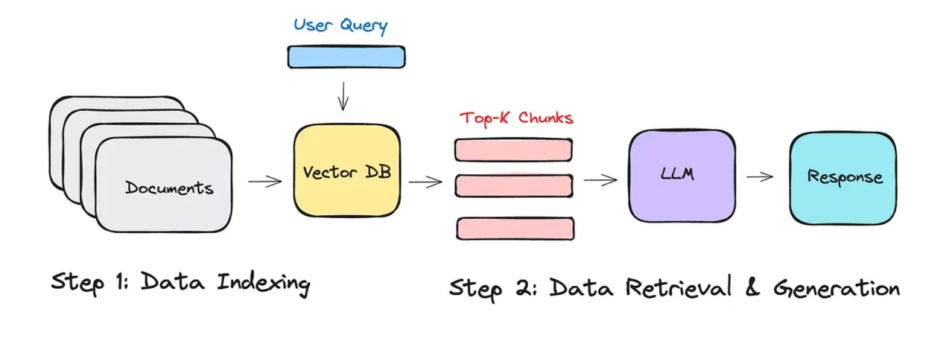
What is RAG
Retrieval-Augmented Generation RAG is a technique that enhances language model generation by incorporating external knowledge.
This is typically done by retrieving relevant information from a large corpus of documents and using that information to inform the generation process

Slide 42
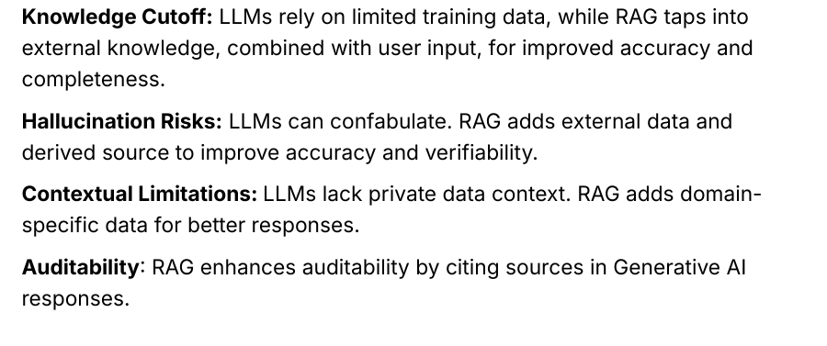
Why do we need RAG ?

Slide 43
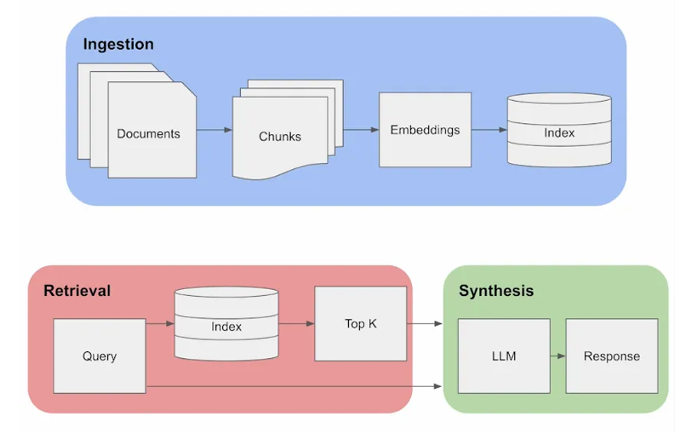
Working of RAG

Slide 44
Components in RAG
Document Loader and Text Processing
Chunking the long documents
Embedding of Chunked documents
Storing the Embedding in Vector DB
Retrieval
Summarization
Evaluation

Slide 45
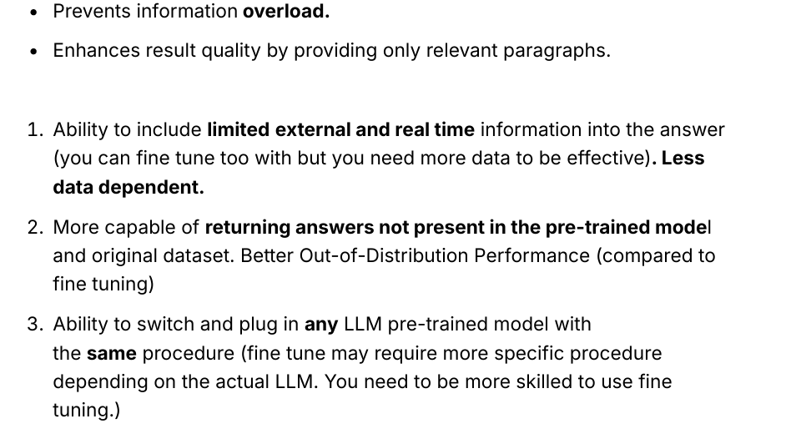
Advantages of using RAG

Slide 46
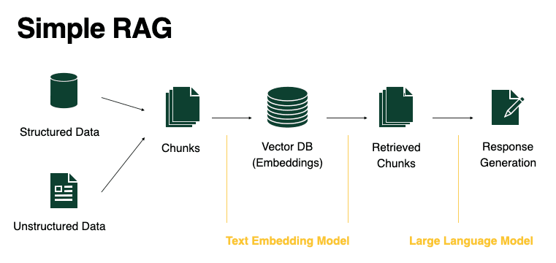
Common use cases
Customer question-answering systems:
In domains such as healthcare, manufacturing, and IT, RAG-enhanced chatbots can field questions by retrieving relevant contextual information from internal knowledge base to respond to customer queries.
For example, consider a healthcare organization employing RAG models to create a system that provides accurate medical answers by accessing and interpreting medical literature or internal trial records

Slide 47
Common use cases
Customized Data Retrieval with RAG:
RAG enables precise and tailored data retrieval by leveraging external databases, internal knowledge repositories, or real-time data sources.
It identifies and extracts the most relevant information to provide customized responses based on user queries.
Content creation and summarization:
RAG models make content creation easier by finding useful information from different places, including internal knowledge base. They can assist with condensed reports and summaries.
For instance, writers and researchers at a news company can use an internal RAG models, along with internal knowledge news repository or base, to make news articles or short summaries of long reports.

Slide 48
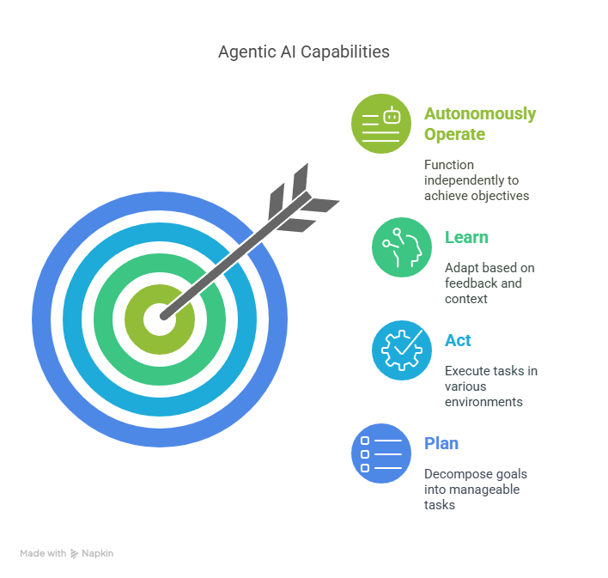
Defining Agentic AI
Agentic AI refers to systems that possess the ability to:
Plan: Decompose complex goals into manageable tasks.
Act: Execute tasks by interacting with various tools and environments.
Learn: Adapt based on feedback and changing contexts.
Autonomously Operate: Function with minimal human oversight to achieve predefined objectives.
Traditional Approach: A consultant uses ChatGPT to draft a market analysis report based on a prompt.
Agentic AI Approach: An AI agent autonomously gathers market data, analyzes trends, drafts the report and iteratively refines it based on stakeholder feedback, all while coordinating with other digital tools and databases.

Slide 49
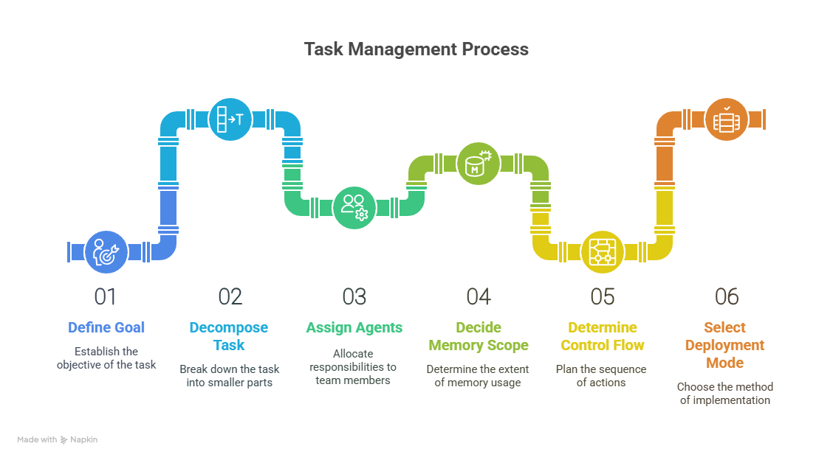
6-Step Method to Build Agent Workflows
Step | Description
1. Define Goal | What should the agent system achieve? (e.g., Generate competitor benchmark report)
2. Decompose Task | Break into subtasks: fetch data, classify, analyze, generate insights
3. Assign Agents | Allocate agents per role: researcher, classifier, summarizer, validator
4. Decide Memory Scope | Will agents remember past interactions, data sources, or project-specific notes?
5. Determine Control Flow | Choose between fixed pipelines or autonomous agents with retry/escalation logic
6. Select Deployment Mode | Prototype locally or deploy on cloud (e.g., LangGraph, CrewAI, AutoGen)

Slide 50
AI Agents: Fully Autonomous || Human-in-the-Loop
Fully Autonomous Agents are Agents that operate independently without human intervention, capable of making decisions and executing tasks to achieve predefined goals.
Key Characteristics:
Autonomy: Operate without direct human control.
Decision-Making: Utilize AI models to make complex decisions.
Adaptability: Can learn and improve performance over time
Considerations:
Require rigorous testing to ensure reliability.
Potential risks if misaligned with organizational goals.
Human-in-the-Loop (HITL) Agents on the other hand are Agents that involve human oversight or intervention at specific stages of their operation, ensuring decisions align with human judgment and ethical considerations.
Key Characteristics:
Collaboration: Combine AI efficiency with human insight.
Control: Humans can intervene or override decisions.
Transparency: Facilitate understanding of AI decision-making processes.

Slide 51
AI Agents: Fully Autonomous || Human-in-the-Loop
Aspect | Fully Autonomous Agents | Human-in-the-Loop Agents
Autonomy | High | Moderately high
Human Intervention | None | Required at key points
Decision Speed | Fast | Slower
Risk Management | High, if not regulated | Enhanced by human oversight
Ideal Use Cases | Routine, low-risk tasks | Complex, high-stakes decisions

Slide 52
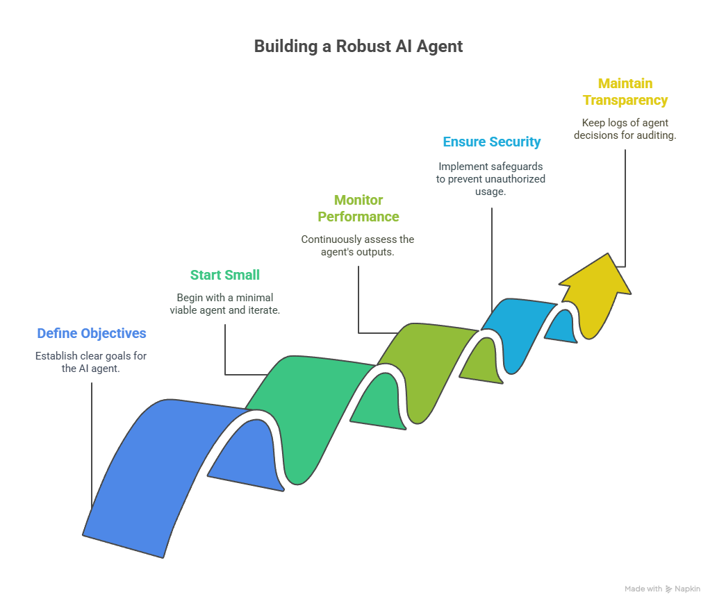
Best Practices for Implementing AI Agents
Define Clear Objectives: Ensure the task aligns with the capabilities of agent.
Start Small: Begin with a minimal viable agent and iterate.
Monitor Performance: Continuous assessment of agent's outputs for accuracy and relevance.
Ensure Security: Implement safeguards to prevent unauthorized tool usage.
Maintain Transparency: Keep logs of agent decisions and tool invocations for auditing.

Slide 53
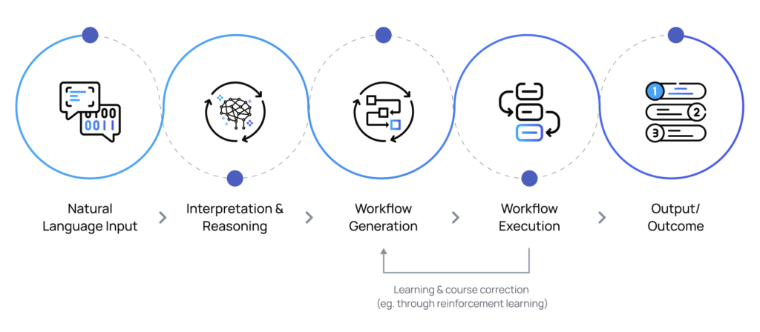
Core Components of Agentic AI Systems
Planner:
Function: Decomposes high-level goals into actionable sub-tasks.
Application: In consulting, planners can break down complex projects (e.g., market entry strategies) into manageable phases.
Executor:
Function: Carries out the tasks defined by the planner, often by interacting with tools, APIs, or databases.
Application: Executes tasks such as data analysis, report generation, or stakeholder communication

Slide 54
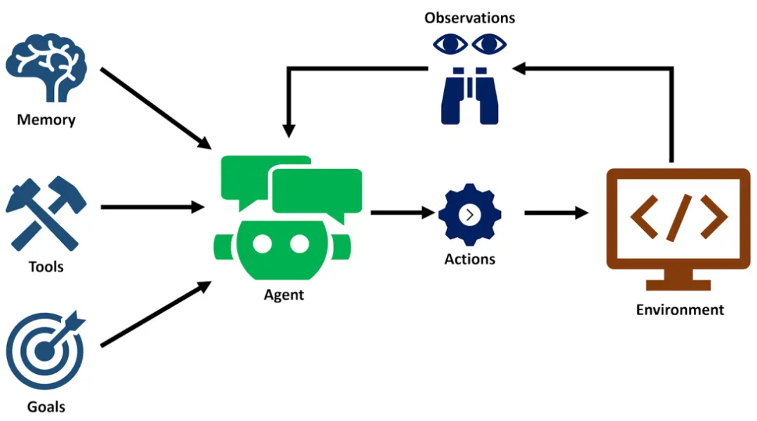
Core Components of Agentic AI Systems
Memory:
Function: Stores context, past interactions, and learned experiences to inform future actions.
Application: Retains client preferences, project histories, and industry-specific knowledge for personalized consulting.
Feedback Loop:
Function: Monitors outcomes, learns from results, and refines strategies accordingly.
Application: Continuously improves consulting recommendations based on client feedback and evolving market conditions.

Slide 55
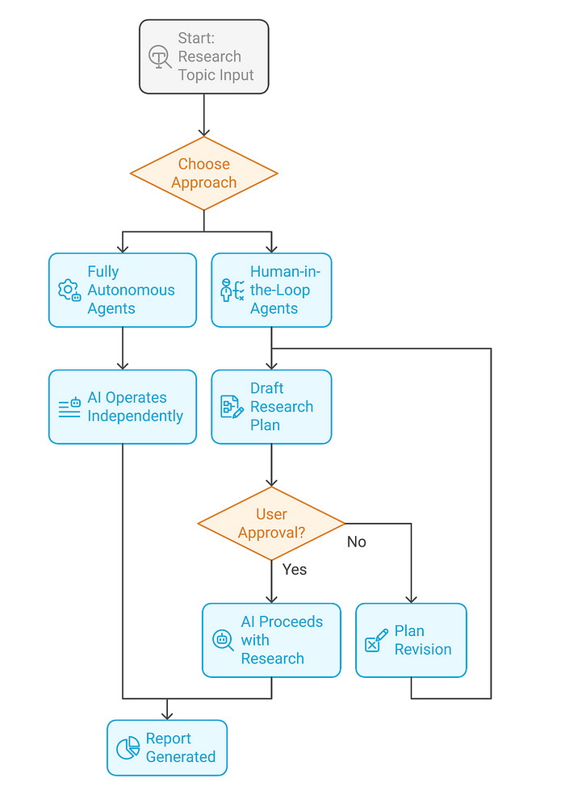
Deep Dive: OpenAI's Deep Research Agent
OpenAI's Deep Research is an AI agent designed to conduct comprehensive, multi-step research tasks autonomously.
Functionality:
Autonomous Browsing: Searches the internet to gather relevant information.
Analysis: Evaluates and synthesizes data from multiple sources.
Reporting: Compiles findings into structured, cited reports.
Use Case: A consultant needs an in-depth analysis of emerging market trends. Instead of manually sifting through numerous articles, Deep Research autonomously compiles a comprehensive report, saving hours of work.

